Slide 1
TOK
Presentation
What makes art art ?

Slide 2
Real life situation I know it when I see it

Slide 3
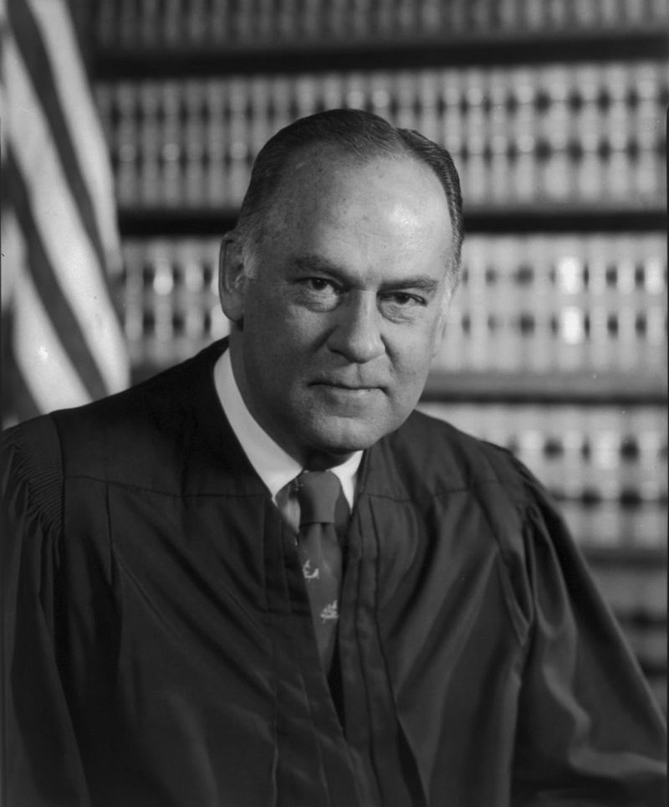
US Supreme Court Justice
Potter Stewart
Here comes the Knowledge Question

Slide 4
To what extent does the artist take advantage of the subjective nature of sense perception to make art “art”?

Slide 5
Claim I
Art is mostly the appreciation of beauty, and art depends massively on how people judge it and consider it as a beauty.

Slide 6
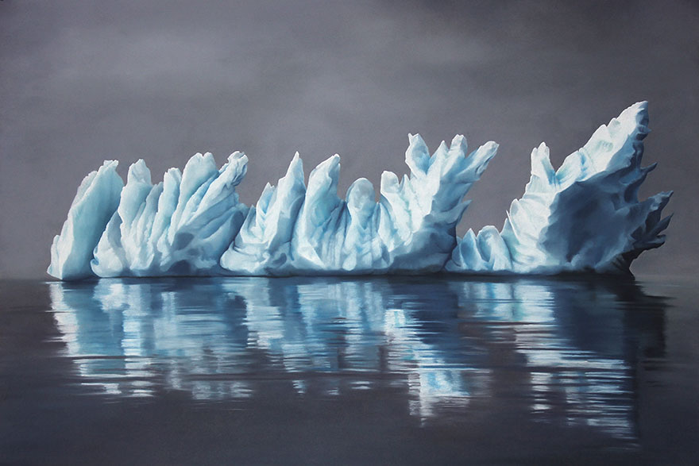
Zaria Forman

Slide 7
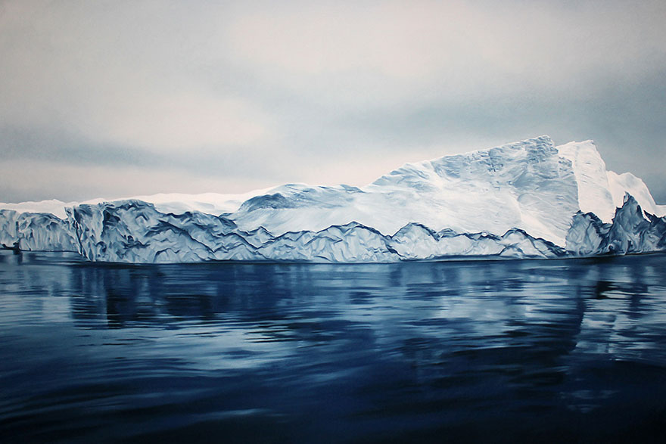
Zaria Forman

Slide 8
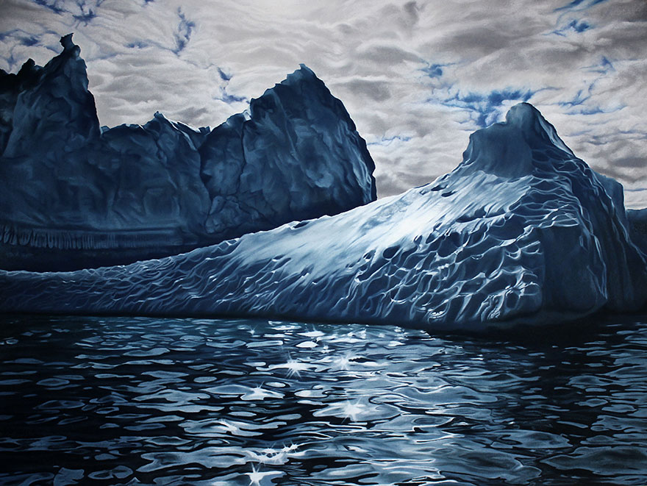

Slide 9
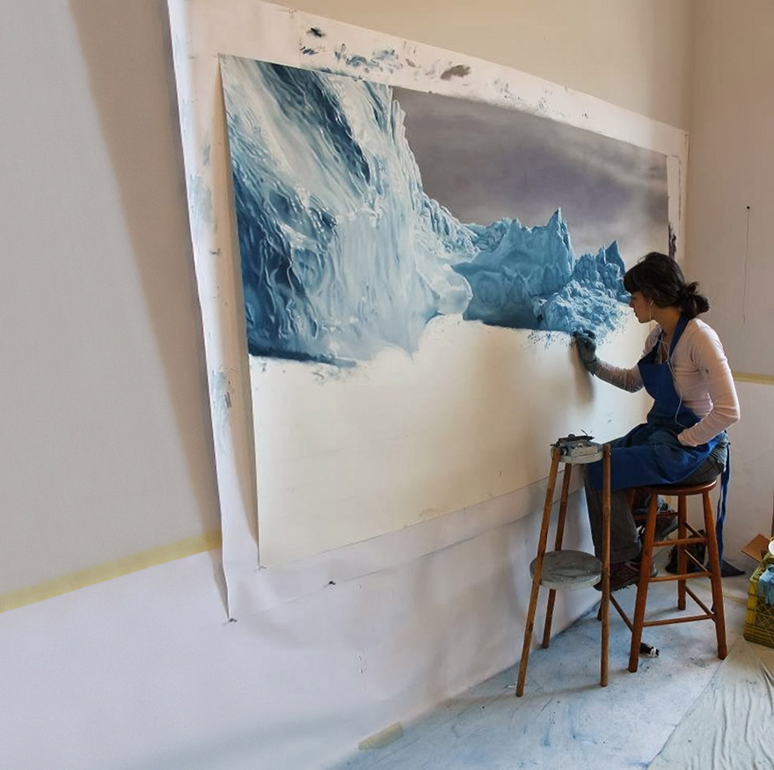

Slide 10
Claim I
Art is mostly the appreciation of beauty, and art depends massively on how people judge it and consider it as a beauty.

Slide 11
Counterclaim I
There are a lot more things people are not able to watch and enjoy, which suggests that people cannot see all beauty. If people do not see that art, then it’s not art?

Slide 12
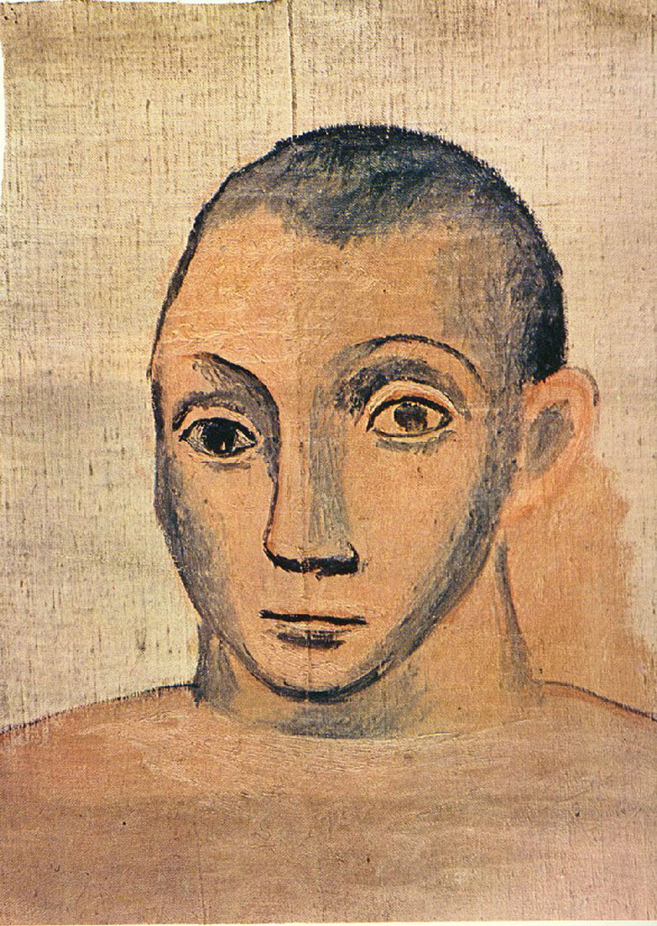
Self-portrait Pablo Picasso
Notes:
A realistic painter, who had considerable fame in that century, developed his technics to incisively reveal the reality in his artworks.

Slide 13
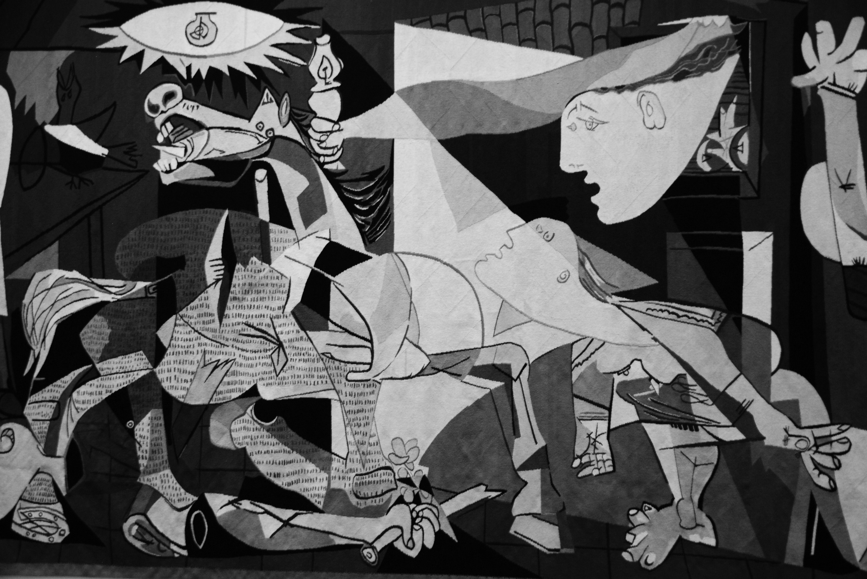
Guernica Pablo Picasso

Slide 14
Claim II
All aesthetic work would possess their creator’s intention and that’s the essence of that art work.

Slide 15
Guernica Pablo Picasso

Slide 16
Counterclaim II
Art is not only about its creator’s purpose, but it’s existence and appreciation. People are able to be inspired, encouraged, relaxed…...
And there are more functions more than the essence of that intention.

Slide 17
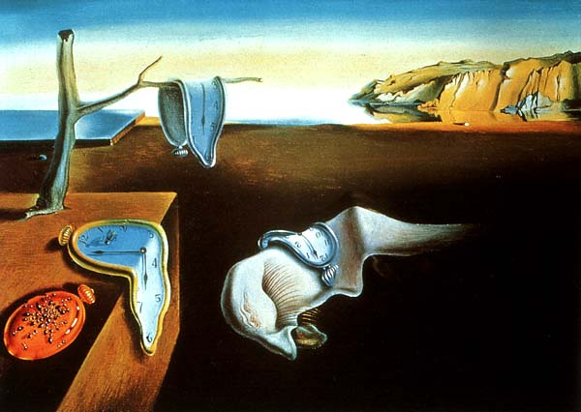
The Persistence of Memory Salvador Dali

Slide 18
Claim III
Art is a banquet of senses.
Artists want to make extremely beautiful artworks to satisfy people to gain fame
Notes:
In 19th century, there is a group of artists called realism. Their artworks are fantastically similar to photos. because the evaluation of an outstanding work mostly depends on how real it looks. Also, the mathematical criteria of beauty like the golden ratio is quite significant in their artworks. Still, the overall looking of a painting or a sculpture basically determine the impression the viewers will get. The realists try to discover better and better technics of using illumination, shadows and colors to create artworks and attract more and more people to follow their comprehension of art.

Slide 19
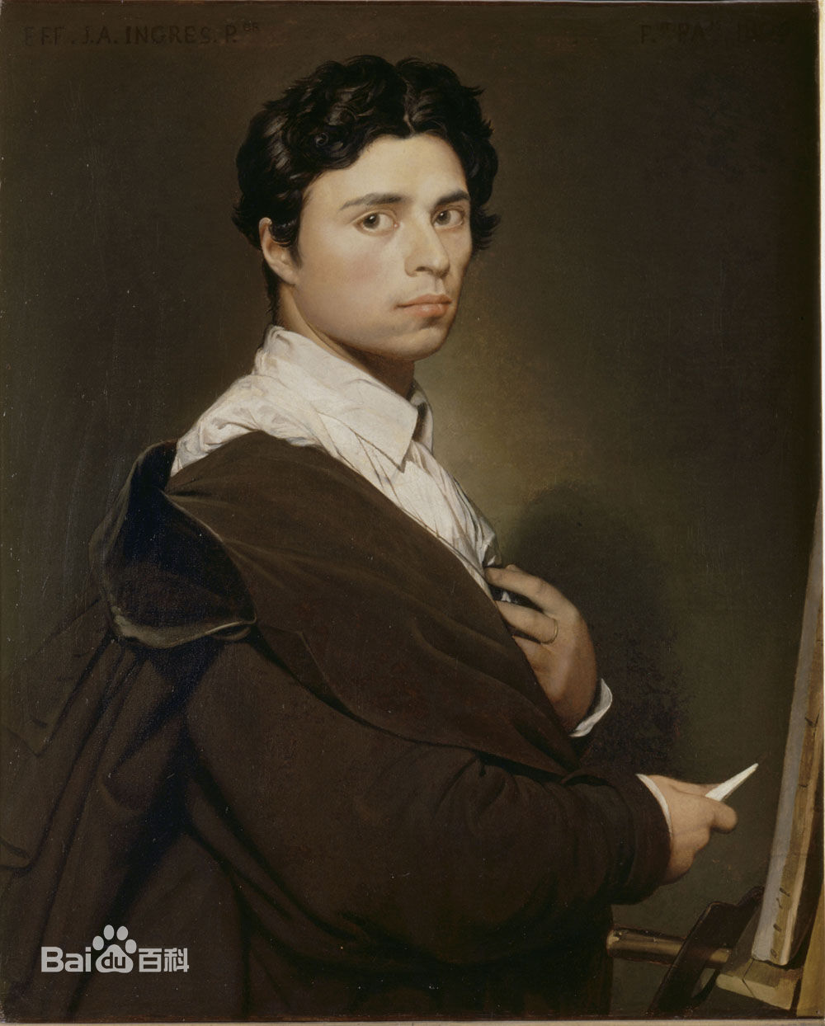
Self-portrait Jean Auguste Dominique Ingres
Notes:
A realistic painter Jean Ingres, who had considerable fame in that century, developed his technics to incisively reveal the reality in his artworks.

Slide 20
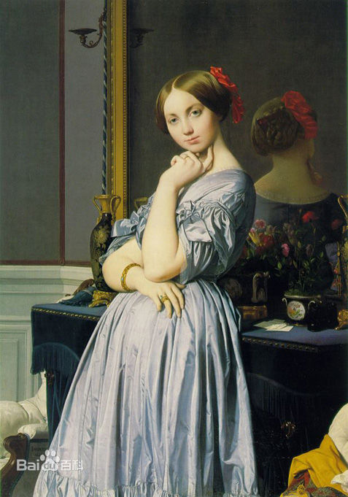
Louise de Broglie, Countess d'Haussonville
Jean Auguste Dominique Ingres
Notes:
His artworks are perfectly precise which makes it is almost the same as what the real scene looked like. The image on the mirror reflects how he focused on the physical effect that enhanced the reality and expanded the observe perspectives. Gorgeous drapes and gloss contains extremely excellent oil painting skills. All the details are so impeccable that make viewers deeply marveled. This is exactly the purpose of these realistic artists.
Therefore, we can make a syllogism: artists want to satisfy people to gain fame; people want to see sophisticated beautiful artworks; so artists want to make sophisticated beautiful artworks to satisfy people to gain fame.
Then, we can see why realistic artists exhausted their imagination to satisfy people’s senses.

Slide 21
Counterclaim III
The immortal artworks usually contains emotional effect to some viewers, not only advanced sensational attraction.
Notes:
However, there is not only one criteria of artworks. The immortal artworks usually contains emotional effect to some viewers, not only advanced sensational attraction
When people were not only satisfied by the enjoyment of senses, actually when they were bored by the gradually optimized technics augmenting the feeling of reality, prophetic artists were attempt to break this stalemate.

Slide 22
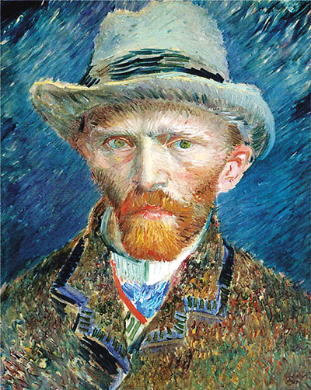
Self-portrait Vincent Van Gogh
Notes:
Vincent Van Gogh is one of the best-known post-impressionist painter. Unlike Ingres, he was a risk-taker. He was not such a famous artist during his life because his innovational artworks, though he really started an era of new art style, which ignore the extreme reality on the artwork, but emphasize the emotion inside the art. Hence, his artworks always give people profound impressions, which bring different emotions to different people.

Slide 23
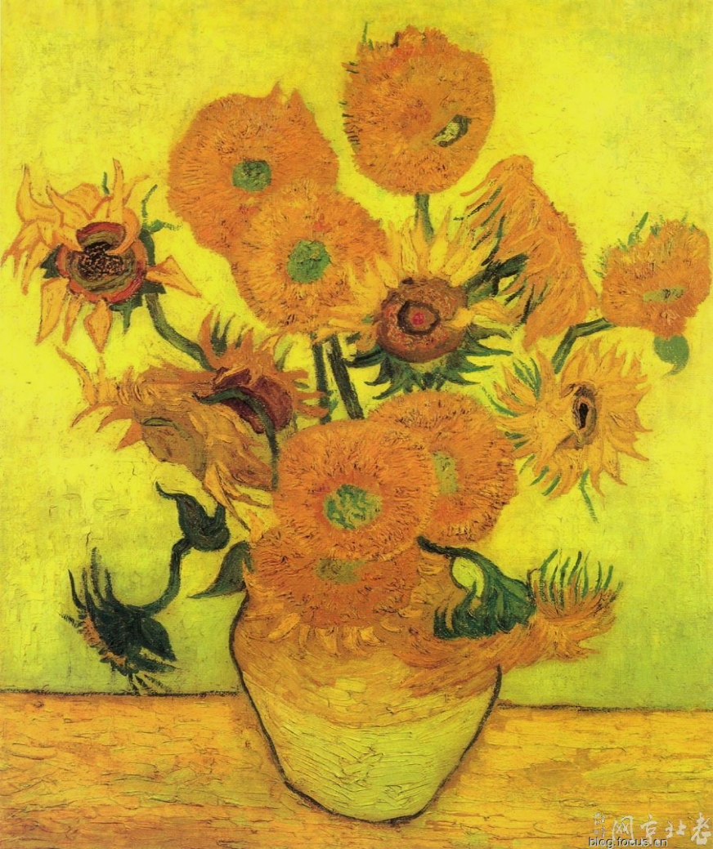
Sunflowers Vincent Van Gogh
In Conclusion
Notes:
In his artwork: sunflowers. Intuition-Bright frame—cheerful feeling----his passion of art
detail: Withering flowers—regretful----his loneliness—mediocre position
Flower-his spirit-sun-energy---vase-insulated-powerless
The late appreciation approved the power of emotion in Van Gogh’s artworks. Now, he is one of the greatest artist in the world forever. And this prove-emotion is necessary in art.

Slide 24
Conclusion
Art is more than the perception of beauty, and the intention of the creator, it is about interpretation.
Notes:
In claim 1, we stated that there are more than one sense perceiving the art.
To some extent, the viewers are able to observe the art not only by watching, but also hearing and touching. This is advanced by the multiple forms of art.
Also, we know that some artworks did not just amused viewers. They have enlightened some people even one century after the work done. They brings emotions effect to these people, some comprehend the painters’ purposes, and some were encouraged by these passionate artworks. The art is the self-portrait of the artists, it illustrated their real understanding of the society they lived or the idea and faith they had. When the artworks can touch one of your important part of memory, you will form your own comprehension. Nevertheless, the art itself is an interpretation of the beauty in its creator’s own mind.
This conclusion really denied the claim of Potter Stewart, the real appreciation of art is not only the evaluation of visual beauty. The invaluable property of art is exactly the inside which is beyond beauty.

Slide 25
To what extent does the artist take advantage of the subjective nature of sense perception to make art “art”?
Notes:
Turn back to knowledge question
Now we have a proper answer for it. Artists in different times have different technics to make their art art. Advantages of the sense enjoyment are necessary in art, but only partially. Art—summation of the artist’s spirit, more about their own faith of art.

Slide 26
Bibliography
Visual Perception
http://www.macalester.edu/academics/psychology/whathap/ubnrp/aesthetics/perception.html
Artworks of Icebergs
http://hope.huanqiu.com/atlas/2014-01/2724529.html
VINCENT VAN GOGH – COLORS AND EMOTIONS
http://www.artcorner.com/vincent-van-gogh-%E2%80%93-colors-and-emotions/
Ingres
http://en.wahooart.com/@@/7Z4QRU-Jean-Auguste-Dominique-Ingres-Louise-de-Broglie,-Countess-d'Haussonville
Louise de Broglie, Countess d'Haussonville
http://art.china.cn/haiwai/2009-08/13/content_3072928.htm

